Slide 1

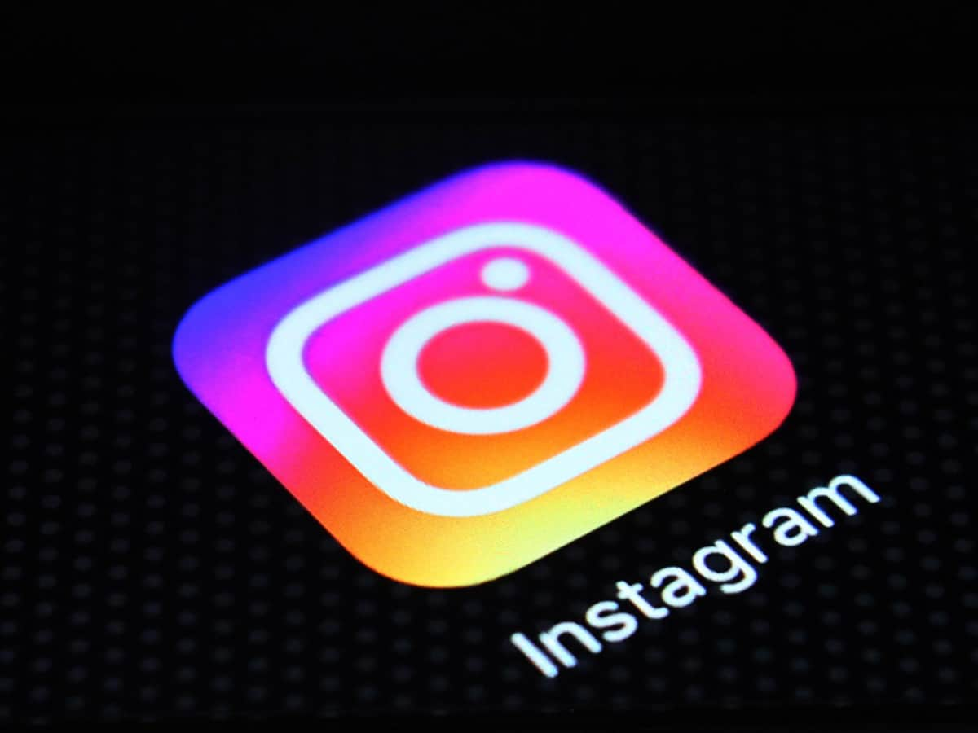


INSTAGRAM USERS ANALYSIS GOVINDU VINOD
LINKEDIN GitHub

Slide 2
PROJECT DESCRIPTION –
The project focuses on analyzing Instagram user data to provide valuable insights for marketing strategies and investor assessment. By leveraging the provided database, we aim to answer key questions and assist the leadership team in making informed decisions.
The project focuses on various aspects such as :
Overall, the Instagram Users Analysis Project aims to support marketing campaigns, improve user experience, and provide valuable insights to ensure the platform's growth and assess its performance for investors.
identifying loyal users.
encouraging inactive users to post.
declaring contest winners.
researching popular hashtags.
determining the best day to launch of ad campaigns.
assessing user engagement.
identifying bots and fake accounts.

Slide 3



MICROSOFT EXCEL
For presenting the result in better way.
TOOLS USED FOR
THIS PROJECT
STRUCTURED QUERY LANGUAGE
For getting the insight from the database.
MySQL Workbench 8.0 CE
For creating Database that’s store the Instagram users data.

Slide 4
Identifying the five oldest users of Instagram.
Identifying users who have never posted a single photo on Instagram.
Determining the winner of a contest based on the user with the most likes on a single photo.
identifying the top five most commonly used hashtags on the platform
Analyzing the day of the week with the highest user registration.
Calculating the total users ,total posts and average number of posts made by users on Instagram.
Identifying users (bots) who have liked every single photo on the site.
These insights help the marketing team reward loyal users, bring back inactive users, improve contests and campaigns, and enhance overall user engagement. They also provide important metrics for investors to assess Instagram's performance, ensuring transparency and confidence in the Platform’s growth and long-term success.
INSIGHTS FROM THIS PROJECT

Slide 5
TOP 5 OLDEST INSTAGRAM USERS
/*1. Task: Find the 5 oldest users of the Instagram from the database provided*/
select * from users
order by created_at asc limit 5;
QUERY
USER_ID | USER_NAME | CREATED_AT
80 | Darby_Herzog | 2016-05-06
67 | Emilio_Bernier52 | 2016-05-06
63 | Elenor88 | 2016-05-08
95 | Nicole71 | 2016-05-09
38 | Jordyn.Jacobson2 | 2016-05-14
OUTPUT

Slide 6
INACTIVE USERS WHO NEVER POSTED A PHOTO
QUERY
USER ID | USER_NAME
5 | Aniya_Hackett
7 | Kasandra_Homenick
14 | Jaclyn81
21 | Rocio33
24 | Maxwell.Halvorson
25 | Tierra.Trantow
34 | Pearl7
36 | Ollie_Ledner37
41 | Mckenna17
45 | David.Osinski47
49 | Morgan.Kassulke
53 | Linnea59
54 | Duane60
57 | Julien_Schmidt
66 | Mike.Auer39
68 | Franco_Keebler64
71 | Nia_Haag
74 | Hulda.Macejkovic
75 | Leslie67
76 | Janelle.Nikolaus81
80 | Darby_Herzog
81 | Esther.Zulauf61
83 | Bartholome.Bernhard
89 | Jessyca_West
90 | Esmeralda.Mraz57
91 | Bethany20
/*2.Task: Find the users who have never posted a single photo on Instagram*/
select
id,
username
from
users
where
id not in (select distinct(user_id) from
photos);
OUTPUT

Slide 7

WINNER OF THE CONTEST IS
Zack Kemmer93
/*3. Task: Identify the winner of the contest and provide their details to the team*/
with most_likes as (
select
photo_id,count(*) as Total_likes from likes
group by
photo_id order by Total_likes desc limit 1)
select
user_id as User_id,us.username as Name,
p.id as Photo_id,
ml.Total_likes as Likes from photos p
join
most_likes as ml on p.id = ml.photo_id
join
users us on p.user_id=us.id;
According to dataset Zack's photo got the highest number of likes among all users.
USER ID | USER NAME | PHOTO | LIKES
52 | Zack Kemmer93 | 145 | 48

Slide 8
According to dataset these are the top 5 most commonly used hashtags on the Instagram
/*4. Task: Identify and suggest the top 5 most commonly used hashtags on the platform*/
SELECT
tag_name AS most_used_hashtags, COUNT(*) AS hashtags_count
FROM
tags
INNER JOIN
photo_tags ON tags.id = photo_tags.tag_id
GROUP BY
tag_name
ORDER BY
hashtags_count
DESC LIMIT 5;
smile
beach
party
TOP 5 POPULAR HASHTAG
fun
contest

Slide 9
Based on Analysis
THURSDAY
&
SUNDAY
are the days when the highest number of users registrations occurs.
BEST DAY
TO
LAUNCH AD
So According to the result launching ad campaigns on these days can maximize the potential reach and engagement of the campaign.
/*5. Task: What day of the week do most users register on? Provide insights on when to schedule an ad campaign*/
Select
DAYNAME(created_at) as DAYS, count(DAYNAME(created_at)) as NUM_OF_USERS_REG
From
users
group by
DAYS
order by
NUM_OF_USERS_REG DESC;

Slide 10
USER ENGAGEMENT
257
100
2.57
TOTAL USERS
TOTAL POST
AVERAGE POST
/*6. Task: Provide how many times does average user posts on Instagram. Also, provide the total number of photos on Instagram/total number of users*/
Select
(select count(id) from photos) as Total_Num_Post,
(select count(id) from users) as Total_Num_Users,
((select count(id) from photos)/(select count(id) from users)) as Average_User_Post;

Slide 11
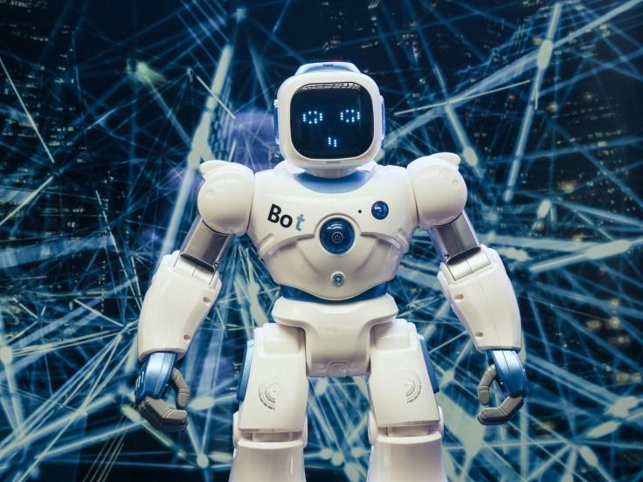
According to analysis these are the users(bots) who like every single photo on the Instagram
USERID | USER NAME
5 | Aniya_Hackett
14 | Jaclyn81
21 | Rocio33
24 | Maxwell.Halvorson
36 | Ollie_Ledner37
41 | Mckenna17
54 | Duane60
57 | Julien_Schmidt
66 | Mike.Auer39
71 | Nia_Haag
75 | Leslie67
76 | Janelle.Nikolaus81
91 | Bethany20
BOTS AND FAKE ACCOUNTS
Task 7: Find users who have liked every single photo on the site.*/
select user_id,username,count(users.id) as total_likes from users join likes on users.id = likes.user_id group by users.id having total_likes = (select count(*) from photos);

Slide 12
CONCLUSION
The project identified the five oldest users of Instagram.
Users who had never posted a single photo on Instagram
The winner of a contest was determined based on the user with the most likes on a single photo.
The top five most commonly used hashtags on the platform
Analysis of user registrations revealed that Thursday and Sunday were the days with the highest number of registrations.
The average number of posts made by users on Instagram was calculated.
Bots that had liked every single photo on the site
This project supports the marketing team in rewarding loyal users, re-engaging inactive users, optimizing campaigns, and improving user engagement.
The investor metrics provide transparency and confidence in Instagram's performance, assuring stakeholders of the platform's growth and sustainability.

